Slide 1
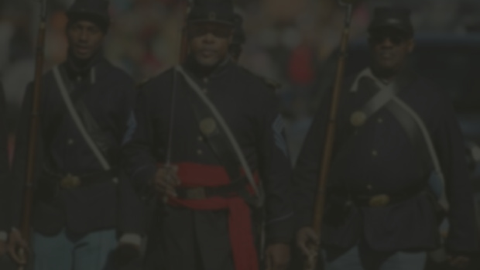
Florida History lesson plan
DEFENDERS OF DEMOCRACY
FLORIDA EDUCATION PROJECT BY
JOHN G. RILEY
This project is sponsored in part by the Department of State, Division of Historical Resources and the State of Florida.

Slide 2
TABLE OF CONTENTS
Civil War…………………………………. 4
World War I………………………………6
World War II……………………………..9
Korean War………………………………14
Vietnam War…………………………….19
War in Afghanistan……………………27

Slide 3
REGIONS AND COUNTIES REPRESENTED
Northwest
Central East
Escambia
Brevard
Indian River
Volusia
North Central
Central West
Leon
Columbia
Duval
St. Johns
Northeast
Southwest
Duval
St. Johns
Charlotte
Lee

Slide 4
Civil War
1861-1865
Political unrest over the status of slavery between northern (Union) and southern (Confederate) states resulted in the south secession to preserve slavery. War broke out when the federal government refused to acknowledge their secession in April 1861. Union blockades combined with important military victories at Gettysburg and Vicksburg led to Confederate General Robert E. Lee’s surrender, ending the war in April 1865. Approximately 650,000 people died.

Slide 5
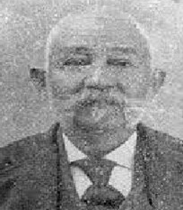
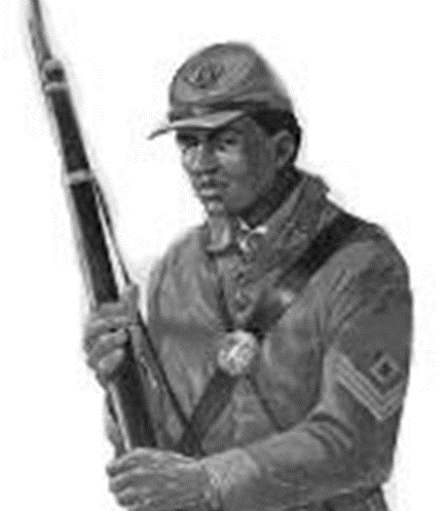
SGT. JOHN SUNDAY, JR.
1838-1925
John Sunday, Jr. was born free in Pensacola, Florida, in 1838. He acquired the basics of education and a trade. During the Civil War, Sunday served in the Union Army, first with the 6th Regiment of the Corps d'Afrique and later with the 78th Infantry, United States Colored Troops. At age 25, Sunday was inducted into the army on May 15, 1863, at Fort Barrancas (Pensacola Naval Yard) and sent to Louisiana. He quickly became a leader within his unit and was promoted to the first sergeant. Sunday participated in the Siege of Port Hudson (near southern Louisiana) and the Battle of Olustee, among other engagements. He joined forces led by General Ulysses S. Grant and joined him in battle along the Mississippi River during this time. Sunday became a sergeant through his merits, and his role placed him close to the general. The two became friends, and, as they remained together through the balance of the war, that friendship was sustained. When the war ended, and Sunday returned to Pensacola, he remained in contact with General Grant. In Pensacola, John Sunday employed his skills and, perhaps with some assistance, he became a home builder. One record indicated that his firm constructed more than 100 houses over time, some of them in Seville Square’s historic district. Later, many of these were restored and became offices or private homes. With business success, John Sunday’s financial state improved; one source claimed that by 1900, he was one of Pensacola’s wealthiest Afro-Americans. He was one of those who helped establish St. Joseph’s Catholic Church.
Blanchard House Museum | Punta Gorda, FL
1ST SGT. OWEN B. ARMSTRONG
1838-1914
Owen B. Armstrong was born free on February 12, 1838, at Halfmoon Township in Centre County, Pennsylvania, as one of nine children. At age 25, he enlisted with Company D, 2nd Infantry Regiment of the U.S. Colored Troops, and was appointed First Sergeant at enlistment. The 2nd was ordered to the Department of the Gulf in December 1863 and saw duty in New Orleans, Louisiana, and Ship Island, Mississippi, until they were ordered to Key West, Florida, in 1864, followed by other stations across the state, including Tampa, Fort Myers, and St. Andrews Bay.
After his unit mustered out in January 1866 in Key West, FL, Armstrong participated as a delegate for the Florida Constitutional Convention of 1868 in Leon and Wakulla Counties. He also served as Leon County Commissioner from 1869-to 1870. From 1880 he served as a teacher in Leon County and later a carpenter. He retired to Punta Gorda, FL, in 1910 and remained there until he died in 1914, but not before participating in Punta Gorda’s first election and town incorporation in 1887.
North Central Region, Leon County

Slide 6
World War I
1914-1918
World War I, or the Great War, began in 1914. The U.S. remained neutral but still aided Britain and its allies. A combination of propaganda, German submarines sinking American ships, and a telegram from Germany to Mexico urging Mexico to attack the U.S. led to the U.S. declaring war on Germany and her allies in 1917. This tipped the balance in Western Europe, and the Allies won in 1918, setting the stage for the U.S to be a world power.

Slide 7
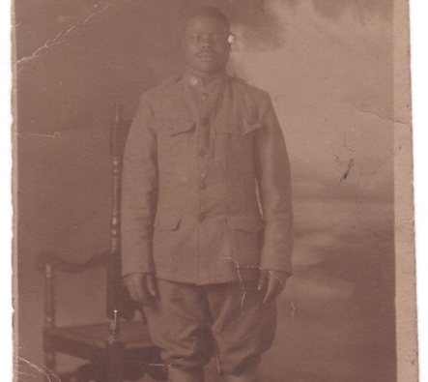
PVT. JASON WAITMAN
1895-1936
PFC WILL ERNEST JONES
1893-1975
During World War I, Jason Waitman served in the 547th Engineer Service Battalion of the US Army. Born in Lake City, Florida, Jason was the ninth of eleven siblings. Before his military service, he worked as a driver in Saint Augustine, Florida. While the four eldest siblings did not receive more than one or two years of schooling, they all knew to read and write, which was uncommon for an African American household in 1900 since only forty-four percent of black Americans could read and write in that era. At fifteen, Jason attended school, knew to read and write, and worked on his father’s farm. On August 4, 1918, he was inducted and sent to Camp Devens, Massachusetts. He joined the 547th Engineer Service Battalion, either in Camp Humphreys, Virginia, when the battalion was formed, or in Camp Merritt, New Jersey, where the Battalion transited before leaving the United States from Hoboken, New Jersey. Private Jason Waitman, with his battalion, boarded the USS Leviathan on October 27, 1918, for Liverpool, England. On Nov 3, 1918, they reached their destination and shipped out to Cherbourg, France, where they arrived on November 10, 1918, before the Armistice. The 547th Engineers spent most of their service in the Northern District and the upper Loire Basin in France. It was attached to the 20th Forestry Engineers and worked on the Fuelwood project to provide wood to the American Expeditionary Forces (AEF). The 20th Forestry and the 547th Engineers used 107 sawmills on French soil to address this crucial need for timber to build railroads, docks, storage units, shelters, hospitals, bridges, trenches, and to keep the troops warm in the wintertime. The 547th Engineers sailed back home onboard the USS Floridian, on July 5, 1919, from Bordeaux, France, to Brooklyn, New York, where they arrived on July 15, 1919. After the war, Jason returned to Columbia County, FL, where he resumed his position as an iceman. On September 16, 1921, he married Elmira Tunsil. He died in St Augustine on December 9, 1936, of Lobar Pneumonia and was buried on Dec 14, 1936, in St Augustine National Cemetery.
North Central Region, Columbia County
Will Ernest Jones was born in Orangeburg, South Carolina, to a sharecropping family. As a married adult, to leave the property he was living on, he had to give away his wife’s wedding band. He moved to Brooksville in 1910. Will enlisted in the army in 1917, serving two years in France during WWI. He received several medals, including the Purple Heart and the WW1 Victory Medal. He was the father of 7 children. In the late 50, he and a neighbor tried to start a National Association for the Advancement of Colored People (NAACP) branch. He was a member of Bethlehem Progressive Baptist Church. He died at the age of 81 in 1975.
Central West Region, Hernando County

Slide 8
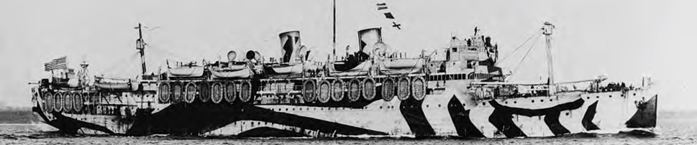
PVT. LEONARD PALMER FULFORD
1896-1918
Leonard Fulford was born to local fisherman Earnest Fulford and his wife Hester in Punta Gorda, Florida. He is said to have been in the initial class of the new colored school and attended through 6th-8th grade. In May 1917, after the U.S. entered the First World War and Congress passed the Selective Service Act, Fulford registered while employed at the Cambria Steel Company in Johnstown, Pennsylvania. One month later, Fulford was drafted as one of 26 African American men from Punta Gorda that served in the war. Private Fulford left Punta Gorda on the 20 of June for his assignment to the 807th Pioneer Infantry.
Pioneer infantry units were considered among the elite regiments for black troops. The unit consisted of white officers, black troops, and specialists such as mechanics and carpenters. While not assessed combat units, their work on the front lines and shifts in the lines of combat meant these units experienced direct action with the enemy. The 807th arrived in France aboard the U.S.S. In time for the Meuse–Argonne, Siboney was the principal engagement of the American Expeditionary Force (AEF) during World War I. It was one of many Allied attacks known as the Hundred Days Offensive, which ended the war. On October 11, 1918, just 114 days after leaving home, Private Fulford succumbed to the dreaded Spanish Influenza and died in a hospital in France. His body departed St Nazaire on August 24th and arrived 11 days later in Hoboken, New Jersey, on September 4, 1920, aboard the troopship Princess Matoika. He is buried at the Carl Bailey Cemetery in Punta Gorda.
Southwest Region, Charlotte County

Slide 9
World War II
1939-1945
WWII began in 1939. Like the Great War, the United States remained neutral but still aided Britain and its allies and placed an embargo on Japan. Japan attacked Pearl Harbor in Hawaii on December 7, 1941. The U.S declared war on Japan while Germany declared war on the U.S. for this. The U.S. fought with Britain and France in Europe and primarily by itself in the Pacific Ocean with assistance from Australia and New Zealand. Germany surrendered in May 1945. Three months later, Japan followed suit after the U.S. dropped two atom bombs on the cities of Hiroshima and Nagasaki in August 1945. The U.S emerged as a superpower along with the USSR.

Slide 10
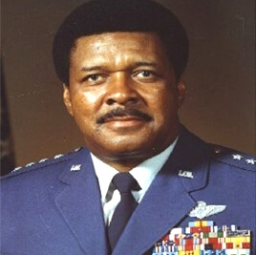
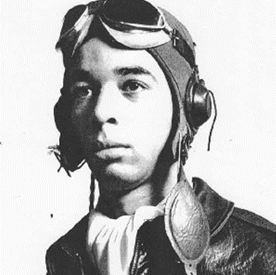
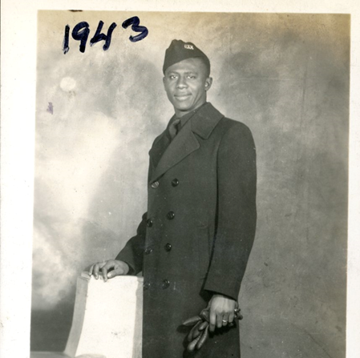
GEN. DANIEL “CHAPPIE” JAMES, JR.
1920-1978
LT. JAMES R. POLKINGHORNE, JR.
1921-1944
ROBERT WISE
1919-2015
Born in Pensacola, Florida, the youngest of seventeen children, Daniel "Chappie" James, Jr. (1920-1978) rose to attain the rank of the four-star general-the highest rank of the peacetime American military and was the first African American to attain that rank. Early on, his parents had imbued him with personal and national pride and a singular drive that motivated him his whole life. At the Tuskegee Institute, James enrolled in the Army Air Corps unit formed to train black pilots. After assisting with the training of pilots during World War II, James became the leader of a fighter group in the Korean War. He developed innovative tactics for providing close air support for advancing ground forces. He served with distinction in Vietnam and then became a public affairs officer in the Department of Defense. Between 1970 and 1974, James served as the Pentagon's chief spokesman for youth and civic organizations. James was promoted to the four-star grade and assigned as commander in chief, NORAD/ADCOM, Peterson Air Force Base, Colo., Sept. 1, 1975. He had operational command of all United States and Canadian strategic aerospace defense forces in these dual capacities. General James's importance transcends his unprecedented achievements as an African American in the military and his role as a spokesman for the patriotic community. He was an early and important proponent of black self-improvement through education, training, and the tireless pursuit of excellence. He became the very embodiment of the American dream.
Northwest Region, Escambia County
Pensacola native Lt. James R. Polkinghorne, Jr. was born on June 16, 1921, to Dr. James and Maggie Polkinghorne, respected business owners in Pensacola, Florida. He was the only son of six children and graduated from Booker T. Washington High School in 1938. Polkinghorne attended school at Florida A&M College (now University) before entering military service in World War II. He trained as a Tuskegee Airman fighter pilot (99th Pursuit Squadron) and served in Italy. His sister, Neomi M. Polkinghorne, also performed at Tuskegee Army Airfield alongside her brother, making them a rare sister/brother Documented Original Tuskegee Airmen (DOTA) combination. While on a combat strafing mission, Polkinghorne was last seen flying into a cloud bank. He was listed as missing in action and later reclassified as presumed killed. His body and aircraft were never recovered or identified. Polkinghorne was the only Tuskegee Airman fighter pilot from Florida to die in combat during the war. His family received his posthumously awarded Purple Heart Medal seen above. Other items included are his pilot’s earphones, his Tuskegee Airman cadet yearbook, and a letter from the Army noting his continued missing in action status. In 1948, Florida A&M University honored Polkinghorne by naming a two-story apartment complex Polkinghorne Village. Today, FAMU Village is built on Polkinghorne Village's grounds once stood.
Northwest Region, Escambia County
Robert Wise was born in Jacksonville, Florida, and was raised in Philadelphia, Pennsylvania. He spent 22 years in the US Navy, serving as a steward and engineer on various ships. He performed before, during, and after World War II. He retired from the Navy in 1960. After retirement, he worked as a Power Plant Engineer with the City of Philadelphia. He was a life member of the Fleet Reserve Association and the VFW. He was a past member and held office in the Jacksonville Camera Club.
Northeast Region, Duval County

Slide 11
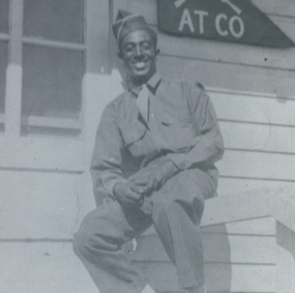
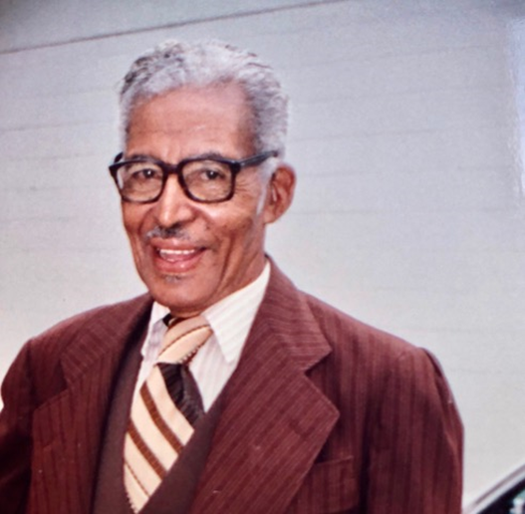
PVT. WILLIAM CHASE
1920-2016
SEAMAN, 1ST CLASS WILLIE LEE MITCHELL
1926-2007
ROCHELLE GONZALES
1911-2002
William Chase of St. Augustine, FL, was born in 1920. He served in the Army beginning in 1942 for the 92nd Infantry, AT CO 365th regiment. He received numerous awards throughout his career, including the Bronze Star, Army Good Conduct Medal, American Campaign Medal, European–African–Middle Eastern Campaign Medal, World War II Victory Medal, Combat Overseas Service Medal, and Army Service Medal.
Northeast Region, St. Johns County
Seaman First Class, V6 - USNR, Willie Lee Mitchell entered the Navy in Jacksonville, Florida, in 1943. The large participation of Black military personnel entering the war coincided with his entry. He completed his basic training in Great Lakes, Illinois, and was assigned to Port Chicago, California. During his tour, the Mutiny occurred, where reportedly he was knocked out of his bunk because of the explosion. He completed his tour of active duty in 1946. Willie is a native of Florida and came of age in Brooksville. He attended public schools through 7th grade. He worked as a truck driver, hauling citrus and produce for a year. He retired from Florida Rock Corporation in Brooksville.
Northeast Region, Duval County
Rochelle Gonzales was born in Brooksville, Hernando County, Florida, and came of age during one of the country’s most racially charged eras, the first three decades of the 20th century. He attended the local public schools in Hernando County, which did not offer the 12th-grade diploma to Blacks at the time. Nevertheless, Rochelle developed competent literacy skills. He enlisted in the Army in the mid-40s and severed overseas. Upon his return to Brooksville, he wanted to serve his community. He served as a trustee and superintendent of Sunday school at Mt. Zion African Methodist Episcopal Church in Mondon Hill. He was a member of the Prince Hall Masonic Lodge and Burial Society. He was the father of 5 girls, and one of his daughters was the first black student to graduate from the former white Hernando High School. Several students out of his Sunday school were pioneers in desegregating the public schools of Hernando County, Florida. He died a patriot and a beloved community elder.
Central West Region, Hernando County

Slide 12
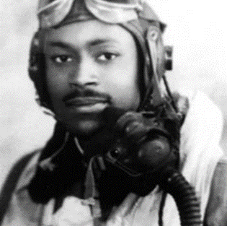
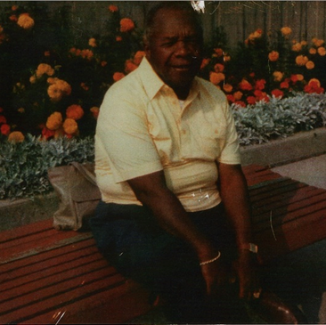
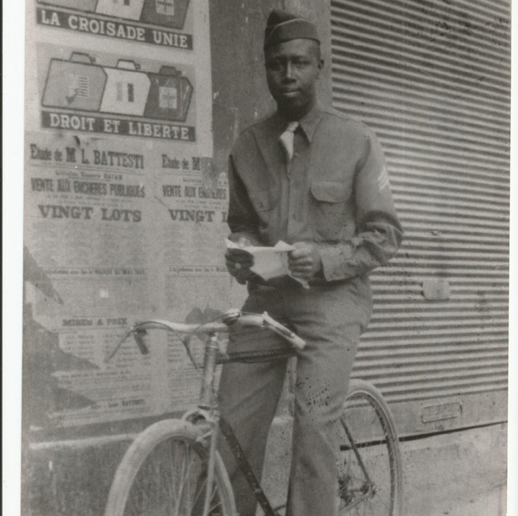
1ST LT. CHARLES PHILLIP BAILEY, SR.
1918-2001
2ND LT. RUDOLPH ISRAEL
1917-2006
STAFF SERGEANT EUGENE H. ROSIER
Staff Sergeant (SSG) Eugene H. Rosier entered the Army following the bombing of Pearl Harbor. Being a brilliant young Soldier while serving in North Africa during WWII, he passed the Army Officer Exam, where his packet was mysteriously “Lost.” He retook the exam and scored the third-highest score in the African Theater. He discovered he was denied the opportunity to become an Army Officer due to his Company Commander’s boldly racist recommendation that the Army had enough nig--- Officers and didn’t need anymore. Undaunted by the racist challenges, SSG Rosier completed his tour in Africa and France, enrolled and graduated from Florida A&M University, married, and started a family. Ironically, SSG Rosier’s sons earned the military ranks of Corporal (US Marines), Senior Master Sergeant (US Air Force (, Command Sergeant Major (US Army), and Major (US Army).
Charles Phillip Bailey was born on November 25, 1918, in the Bailey home in Punta Gorda, Florida. Bailey was the sixth child of 12 children to Archie and Josephine Bailey. Of the 12 children, 9 lived to adulthood. Charles attended elementary and middle school at the Baker Academy in Punta Gorda. As Charles grew up, he was a paperboy for the local newspaper, The Charlotte Herald. There was no high school for African Americans in Punta Gorda at the time, so Charles went to high school at the Howard Academy in Ocala, Florida. After graduating, Bailey earned a football scholarship to attend Bethune-Cookman College in Daytona Beach. The college’s founder, Mary McLeod Bethune, arranged for Bailey’s transfer to the Tuskegee Institute after his first two years at Bethune-Cookman, where he enlisted in the Army Air Corps at the age of 23 and learned to fly. Bailey was commissioned a second lieutenant in the U.S. Army Air Corps. He was later shipped out for overseas combat duty as part of the Allied invasion of North Africa. Bailey was one of the pilots who served under Gen. Benjamin O. Davis Jr., the Army's first Negro general, who commanded the elite 332nd, all-Negro group. After the war, Bailey reenrolled at Bethune-Cookman College and completed two more years graduating with a bachelor’s degree in Elementary Education. He became a schoolteacher in DeLand, Florida, before eventually retiring. Charles returned to school to study mortuary science at the Cincinnati College of Embalming. He later opened the Charles P. Bailey Funeral Home, which served the Deland, Florida, community for decades. He lived the remainder of his life in Deland, Florida. In 1995, Bailey was diagnosed with Alzheimer's disease and died on April 10, 2001, at 82.
Southwest Region, Charlotte County
Rudolph Israel attended Florida Normal and Columbia University’s School of Journalism in New York City. He wrote for a foreign news service there for 30 years. He served in WWII as a Second lieutenant and was later discharged honorably in 1953.

Slide 13
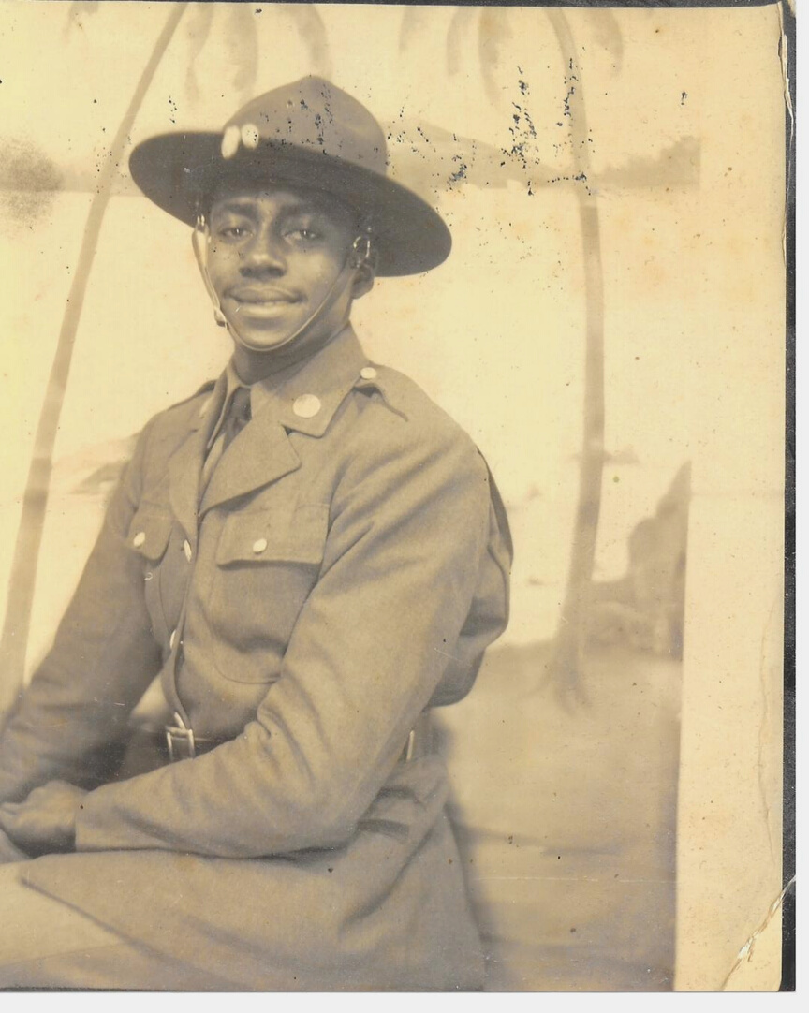
LLOYD E. HADLEY
NOVEMBER 7, 1920 – JULY 15, 2002
Lloyd E. Hadley joined the United States Army on December 14, 1940. While proudly serving his country, he participated in the Normandy Invasion during World War II. He was honorably discharged at the rank of 1st Sergeant on September 23, 1945. Lloyd was educated in the public schools of Leon County. Upon graduating from Florida A & M University, he taught at Florida A & M University High School, Dillard High School, and Everglades Junior High in Fort Lauderdale, Florida, and retired from Miramar High School, Florida. Upon retiring from the Broward County School System and returning to Tallahassee, Lloyd assisted with the Greenwood Cleanup and Restoration Project. Lloyd’s service to his community included membership in Kappa Alpha Psi Fraternity, Inc., NAACP, and a Master Mason of Cyrus Lodge No. 43.
His favorite pastimes were volunteering at Fairview Middle School and Rickards High School and attending high school and Florida A & M football and basketball games.

Slide 14
Korean War
1950-1953
After WWII, the USSR and the United States divided the Korean peninsula into two zones on the 38th parallel, with the North being communist and the South democratic. The North wanted to unite the peninsula by invading the southern zone, leading western powers, including the United States, to aid the South in 1950. General Douglas MacArthur drove North Korean forces back over the 38th parallel. Still, he continued pushing northward and even suggested bombing cities in China, leading President Truman to relieve him of his command. In 1953 after a stalemate, the war ended with the borders almost unchanged.

Slide 15
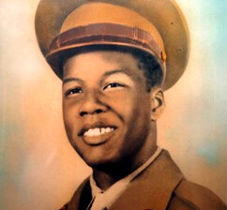
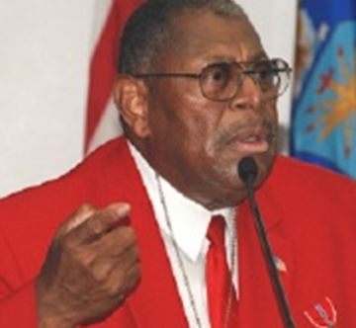
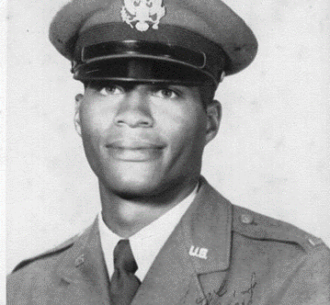
PVT. ROSAMOND JOHNSON
1933-1950
CMSGT. WALTER RICHARDSON, RET.
served 1949-1979
2ND LT. DR. ROBERT B. HAYLING
1929-2015
When Pensacola native Rosamond Johnson was 15, he lied about his age to enroll in the US Army so he could help support his family. As a member of the 24th Infantry stationed in Japan, Johnson and his regiment were some of the first soldiers deployed to fight during the Korean War. On July 26, 1950, Johnson was fatally wounded and died after pulling two wounded soldiers to safety during conflict and attempting to assist a third. He was 17 years old. On August 21, 1950, Johnson was posthumously awarded the Purple Heart medal for his heroic actions. After the Korean conflict, the Sunset Riding Club Inc. proposed naming the area for Private Johnson to honor and remember his sacrifice and the beach’s importance within the community. When the Gulf Islands National Seashore was established and the Perdido Key Area (a refuge where black citizens of the Jim Crow era could enjoy the beauty and recreational opportunities of the beach and the Gulf) was added, the name Rosamond Johnson Beach was retained for the developed swim beach. Gulf Islands National Seashore and its partners hold an annual Rosamond Johnson Commemoration each May to remember the service and sacrifice of Private Johnson and his family. A monument and wayside about Private Johnson and his service in the United States are permanently installed at the beach.
Northwest Region, Escambia County
Born and raised in Pensacola, Florida, Walter Richardson entered the Air Force on 13 January 1949 to serve his country and provide for his family. His career in the Armed Forces spanned thirty years and included service in the Korean and Vietnam Wars. Walter was an original member of the revered Tuskegee Airmen, training at Tuskegee Army Airfield in various disciplines that would serve him well throughout his entire career. He was presented with the Congressional Gold Medal for his service as a Tuskegee Airman. During his time in the military, Walter was one of over 1,000 enlisted men selected to integrate into the Armed Forces. His unwavering commitment to service and immense leadership skills were recognized when, while stationed at Dover Air Force Base, he became the first African American to be promoted to Master Sergeant in the field maintenance squadron. He retired at the highest enlisted level in the Air Force, Chief Master Sergeant, as the Senior Enlisted Advisor to the Commanding General of the 1st Special Operations Wing, Hurlburt.
Field, Florida. During his service in Vietnam in the 1970s, he received the Bronze Star for bravery. He was also twice selected as “Airman of the Year” by U.S. Air Force.
Northwest Region, Escambia County
Dr. Hayling was born in Tallahassee, Florida, Charles C. Hayling, Sr., an academic who had a 33-year career at Florida A&M University, and Cleo Bagner Hayling. He and his three siblings all attended Florida A&M and received graduate education. In 1951, he was commissioned as a second lieutenant in the US Air Force with training from the Air Officer’s Candidate School. Before moving to Nashville, Tennessee, he served for four years to study dentistry. Dr. Hayling received a Doctor of Dental Surgery degree from Meharry Medical College School of Dentistry in 1960, where he first became involved in civil rights by participating in marches and lunch counter sit-ins. He is considered the “Father of the Civil Rights Movement in St. Augustine.” He is the first Black Dentist in Florida to be elected to the American Dental Association's local, regional, and state components. He served as an adult advisor to the NAACP Youth Council and as the head of the St. Augustine Chapter of the Southern Christian Leadership Council for eleven months. There is a park dedicated to Dr. Hayling in Lincolnville, a historically Black neighborhood in St. Augustine, named Dr. Robert B. Hayling Freedom Park.
North Central Region, Leon County

Slide 16
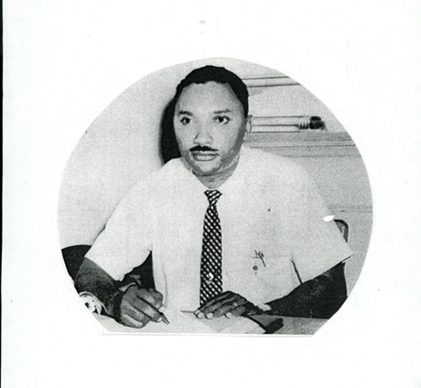
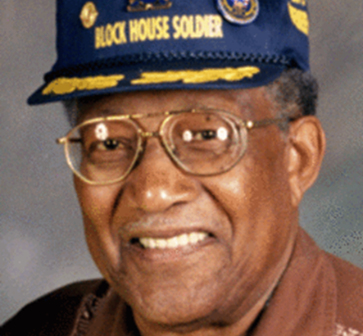
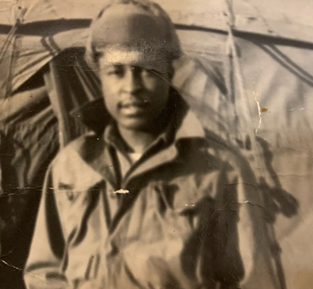
OTIS MASON
b. 1926
PFC JIMMY HARRELL
served 1950-1953
EX-POW JERRY MORGAN
1925-2006
Otis Mason was born and raised in the Lincolnville neighborhood of St. Augustine, Florida. Regarded by his peers as the consummate educator, he served the St. Johns County community as a teacher, a principal, an instructional supervisor, and a superintendent of schools. Mason earned an undergraduate degree with honors from Florida A&M in 1950, where he was named to the university’s Sports Hall of Fame for baseball. Mr. Mason began teaching school at his alma mater, Excelsior, in 1950. His first teaching year was cut short due to the Korean Conflict. He was drafted into the US Army and served two years before returning to the classroom at Excelsior. He received his master’s degree in education administration at New York University in 1958. In 1960, he was named Principal of W.E. Harris School in Hastings, where he remained until joining the St. Johns County School District staff as Supervisor of Elementary Schools in 1966. The Otis Mason Elementary School in St. Augustine bears his name. “Public education has been my life,” he said in a 1998 interview. In his position as Supervisor of Elementary Schools, Mr. Mason was instrumental in implementing full integration of St. Johns County schools.
Northeast Region, St. Johns County
Jerry Morgan was born in Washington, Pennsylvania, and enlisted into the army in 1942. The infantryman was shot in the knee in the biggest, bloodiest battle in Europe in World War II: The Battle of the Bulge, December 1944. At age 25, Jerry went to the Korean War. Within five months, he was a POW held by North Koreans. Among thousands of military service members, Morgan was taken prisoner during that 1950s-era war. He served in the army until 1971 and later moved to Vero Beach in 1979. Jerry retired as a Master Sergeant, receiving a Congressional Black Caucus Veterans Braintrust Award.
Central East Region, Indian River County
Home: New Smyrna Beach, Florida
Army, 1950-1953, PFC
Korean War
Central East Region, Volusia County

Slide 17
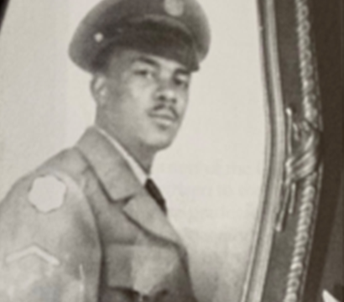
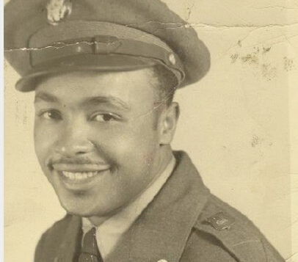
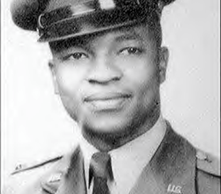
PFC WILLIE FRANK MCGHEE
1927-1951
1ST LT. CARL ADOLPH BAILEY
1929-1957
SGT. CLARENCE WILLIE WALKER
1928-1986
The youngest brother of Charles Phillip Bailey, Carl Adolph Bailey, was born on September 1, 1929, in the Bailey home in Punta Gorda, Florida. With the outbreak of World War II, the Bailey boys heard the call to arms and began to enlist in military service. Carl’s oldest four brothers signed up for service in 1942, and the youngest two enlisted in 1943. Carl’s last brother Arthur (age 17) left, leaving Carl, too young to serve, home at 13. Carl attended Baker Academy for elementary, middle school, and 9th and 10th grade. He attended 11th and 12th grade out of town. While attending Florida A&M College, the conflict on the Korean Peninsula broke out into war in June 1950. He graduated the following year and enlisted in the U.S. Air Force. Two years later, Carl Bailey commissioned a Second Lieutenant in the U.S. Air Force Reserves on 16 Mach 1953 and was immediately put onto active duty. He went to undergraduate pilot training to learn to fly the T-33.
In 1953, the Air Force produced 5,265 pilots—a post-World War II high due to the increased production demands of the Korean War. Only the most promising were trained to be fighter pilots. Following training, Lt Bailey was assigned to the 428th Fighter Bomber Squadron at Taegu Air Base, South Korea. He was assigned as an F-84G Thunderjet pilot. Lt Bailey arrived in post-cease-fire Korea and therefore did not fly in combat. He was promoted to First Lieutenant on 22 September 1954 and was the commander of the 80th Fighter Bomber Squadron (callsign: Headhunters) on Kadena Air Base, Okinawa, Japan, flying F-84 jet fighters. Following his assignment in Korea, he was assigned a stateside tour to Tyndall Air Force Base in the panhandle of Florida. Carl was assigned to the 3631st Support Squadron as a flight commander. It was from Tyndall that he flew his hometown famous flight from MacDill Air Force Base. Carl had called his mother and told her when to look skyward when he’d fly around Punta Gorda’s water tower to say “Hi.” It was the talk of the town for years. Carl was killed in a car accident while en route to visit his fiancée and break off the engagement. He was 28 years old.
Southwest Region, Charlotte County
Willie Frank McGhee, Jr. was raised in Brooksville, Hernando County, Florida, and attended Moton High School. McGhee earned several awards, including the Korean Service Medal, National Defense Service Medal, Purple Heart, Republic of Korea War Service Medal, Republic of Korea Presidential Unit Citation, the United Nations Medal, and a Combat Infantryman Badge. He was killed in Korea, making him one of an estimated 5,000 African Americans to die in the war.
Central West Region, Hernando County
Clarence Willie Walker was a Korean War Era veteran. He entered the army in 1951 and served until being honorably discharged in 1953. Sergeant Walker used the G.I. Bill to earn a Bachelor of Science degree in Agriculture from Florida Agriculture and Mechanical University and earned a Master of Education degree from FAMU. Between his discharge from the army and completion of his degree, he married and moved to Hernando County as the newest Moton High School staff member, where he served as an agriculture teacher. He replaced John D. Floyd; a Korean War Era veteran promoted to principal in 1958. Clarence immediately committed to the Brooksville community. He joined Ebenezer Missionary Baptist Church and eventually became a trustee. He joined Frederick Kelly Elk Lodge in 1970, eventually becoming the exalted ruler. He became a charter member of the Brooksville Branch National Association for the Advancement of Colored People. Since Reconstruction, he became the first African American to run for elective office in Hernando County (County Commission) in 1981. He lived a full life in a short period of time.
Central West Region, Hernando County

Slide 18
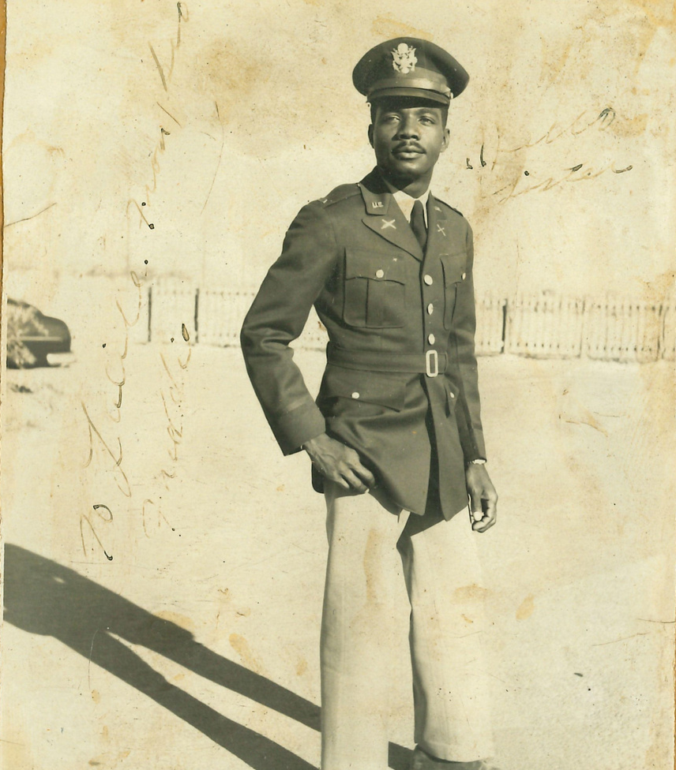
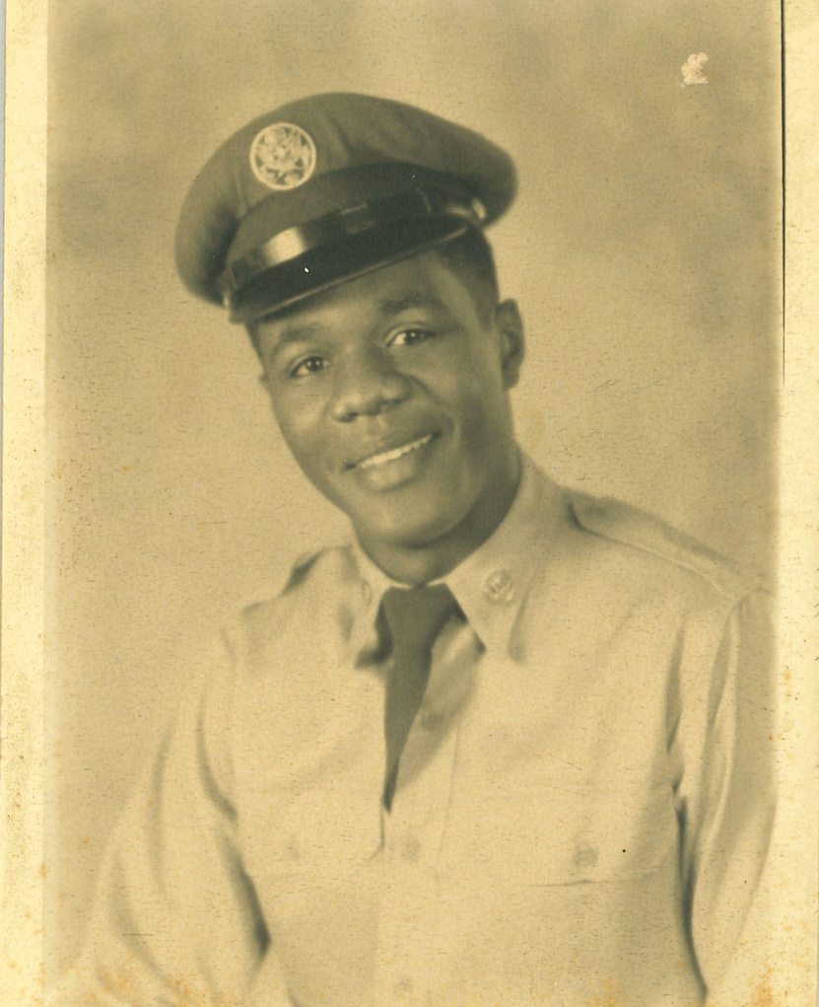
FRED PEMBERTON
MOSE PEMBERTON JR.
1932-2017
Freddie Haynes Pemberton was born on January 20, 1930, in Tallahassee, Florida. Freddie was born with a tremendous destiny and purpose in his life. Raised and nurtured by the late Mary Porter and Moses Pemberton, Freddie graduated from Griffin High School on June 4, 1948. He earned his Bachelor of Science Degree in Industrial Education from Florida A&M College (University) on August 13, 1952, and obtained numerous industrial Arts certifications. In October of 1952, Freddie enlisted in the Armed Forces of the United States and served his country for over three years as a First and Second Lieutenant during his duty period. He was also a AAA Gun Unit Commander - Battery Officer in the Korean War and was awarded the UN Service Medal, National Defense Service Medal, and the Korean Service Medal. Shortly after serving in the war, he returned to the States and married the love of his life, Vera Mae Beeman. He was consistent in his pursuit of excellence in education throughout his entire life. He served as a Scout Master for the Boy Scouts of America in 1962 and was an instructor for the Georgia School of the Deaf in Cave Springs, Georgia. One of the most significant accomplishments that speak to his character and strong work ethic is that he worked in the Atlanta Public School System for over 33 years as a teacher in Prince, Smith, and Southside High Schools and never missed a day. Before retiring on July 1, 1989, Freddie received numerous Vocational Industrial Awards for his outstanding service and participation in developing students preparing for the world of work. Many students knew him because of his dedication.
Mose Pemberton Jr. was born September 21, 1932, in Tallahassee, Florida, attended and graduated from Griffin High School, where he revived the highest academic honors. He entered Florida A& M University as a Biology Major and, after two years, decided to join the United States Air Force in service to the country. He was honorably discharged. He returned to Florida, where he excelled in the insurance and manufacturing industry and spent his later years as the primary caregiver for his parents until their deaths at ages eighty-six and ninety-nine. From the ’80s to the end of 2017, Mr. Pemberton maintained strict military habits of early rising, making his bed daily military-style, and doing push-ups.

Slide 19
Vietnam War
1955-1975
The Vietnamese won independence from France in 1954. After this, the North, supported by the USSR, became Communist while the South, supported by the United States and other anti-communist allies, did not. The North funded southern Vietnamese guerrillas to attack the region in hopes of uniting the country directly. The United States and other Western countries provided military support with varying intensity from 1954 until 1975, when the U.S. left (mostly due to the war’s unpopularity within the country) and The North annexed South Vietnam.

Slide 20
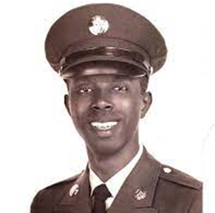
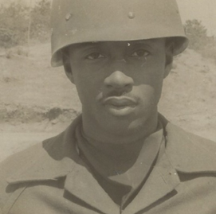
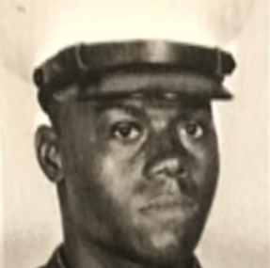
PFC LEO C. CHASE, JR.
1942-1965
SGT. NEAL COATES, SR.
SERVED 1968-1970
SGT. LESTER MITCHELL
U. S. Army, 1957-1967; Active reserve 1977-1997
Leo Chase, Jr. was the first man from St. Johns County, Florida, to be killed in the Vietnam War. The VA clinic in St. Augustine is named after him. On Nov. 15, 1965, Chase was killed in the Ia Drang battle dramatized in the book and film. We Were Soldiers. Chase was a rifleman in Charlie Company, 1st Battalion, 7th Cavalry. He flew into landing zone X-Ray in the Ia Drang Valley of South Vietnam, near the Cambodian border. The helicopter troops were immediately attacked by thousands of soldiers of the 320th, 33rd, and 66th regiments of the North Vietnamese Army in a battle that lasted four days. Outnumbered nearly 10 to one, Chase and the other members of his platoon bravely repulsed many massive ground assaults from the Viet Cong while taking fire from enemy snipers. In the end, Chase and many other members of his platoon lost their lives, but not without accomplishing their objective. The American lines held because of the courage and sheer determination of the Seventh Cavalry.
Northeast Region, St. Johns County
New Smyrna Beach native Neal Coates served on two tours in the U.S. Marines during the Vietnam War. Reflecting on his experience, he said. “It was a very scary experience; turning 21 in Vietnam, coming out of high school, coming out of boot camp, not knowing the area that I’m going into combat. One day you wouldn’t know if you’re going to live. The next day, you don’t know if you will be gone….” Coates was a combat engineer for his first tour with the First Shore Party Battalion, taking out the dead and wounded, and served as an Industrial Relations Noncommissioned Officer with the Ninth Engineer Battalion. During the Battalion’s displacement to DaNang, he displayed outstanding initiative and perseverance despite the extremely adverse conditions and difficulties associated with a combat environment. Demonstrating superb organizational and managerial ability, he skillfully utilized his vast knowledge of industrial relations matters to assist in the selection of over 40 Vietnamese employees to work in the Battalion area after its relocation, thereby enabling his command to resume its normal procedures with a minimum of disruption. Additionally, his extensive knowledge of the tasks to be performed and his proficiency in the Vietnamese language enabled him to communicate successfully with the civilian employees to explain policies, solve relation problems and instruct everyone in his assignment. These qualities of his earned him the Navy Achievement Medal.
Central East Region, Volusia County
Lester Mitchell of New Smyrna Beach, Florida, served in the U.S. Army from 1957 to 1967 and served twenty years inactive reserve from 1977. He was a combat medic. Mitchell has served as a local leader for the National Association for the Advancement of Colored People.
Central East Region, Volusia County

Slide 21
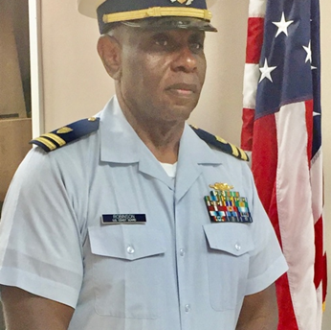
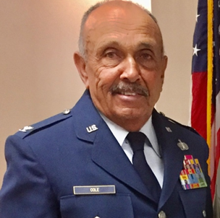
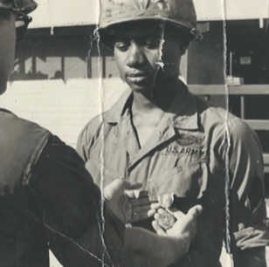
MCPOC JOE ROBINSON
served 1969-1993
COL. HERMAN COLE, RET.
WILLIE C. CHAMBLISS
C Joe Robinson was born in east Texas and joined the United States Coast Guard in 1969. He served 24 years and retired in 1993 as Command Master Chief. He earned a Bachelor of Arts degree in Business Management/Psychology from Columbia College, MO. He completed additional studies in Government Contracting and Procurement for the US Coast Guard Training Center in Petaluma, CA, and Naval Engineering and System Design US Coast Guard Training Center in Yorktown, VA. He was assigned to the USCG Cutter Glacier, the largest military science and research Ice Breaker in the world at that time, which conducted military research at the North and South Poles. Joe received the Coast Guard Commendation Medals (4), Coast Guard Outstanding Achievement Medals (3), Coast Guard Meritorious Service Ribbons (3), and the USCG Athlete of the Year 1993.
Central East Region, Brevard County
Herman Cole was born in Charleston, S. C. and is a graduate of Tuskegee University with a Bachelor of Science in Architectural Science and a Master of Architectural Science Degree. He is a highly decorated Vietnam veteran with 26 years of service in the Air Force, with military decorations including the USAF Legion of Merit, USAF Meritorious Service Medals, USAF Commendation Medal, and the Vietnam Service Medal. He was inducted as a charter member of the Tuskegee University Military Hall of Fame in 2016.
Central East Region, Brevard County
Saturday, November 12, 1966, was the day the union of Willie C and the late Shirley Ann Chambliss became official. Six months after they both said I do, they were separated. America was at war, and Willie (Sonny) was drafted into the United States Army. He was deployed to Vietnam, where he was declared a national hero and received the Medal Bronze of Honor for saving his platoon from an enemy’s ambush by firing his rifle in the air, startling the Vietnamese soldiers, as well as alerting his men that the enemy was nearby. In 1969 after being enlisted for 2 years, Chambliss returned home to his wife. He and Shirley quickly began their family—two girls, Andrea and Shirlonda, and two boys, Willie Jr., and Jeremy Chambliss.
Willie is the Power, Praise, and Deliverance pastor in Orlando, Florida. He was reared in Gifford, Florida, and is 1964 grated of famed Gifford High School. Many are drawn to Willie’s contagious laugh and genuine desire to treat everyone he meets with dignity, compassion, and grace. He is the pastor of Power, Praise, and Deliverance in Orlando, Florida. He is also the grandfather of four grandchildren and one great-grandson.
Central East Region, Indian River County

Slide 22
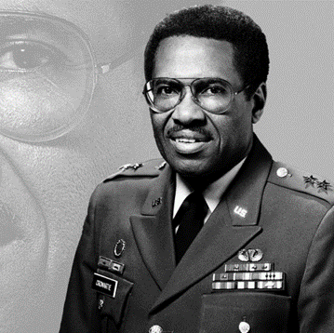
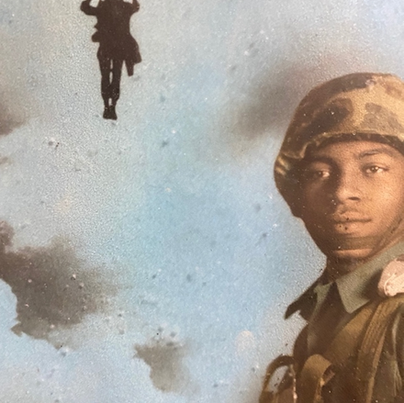
SYLVESTER MCINTOSH
served 1965-1968
MG EUGENE CROMARTIE
1936-2017
PFC CHARLIE LAWRENCE JONES
served 1965-1967
Eugene Cromartie walked a dirt road in Wabasso, Florida, population 600, to a one-building school with no walls and had to be careful to stay on the west side of the railroad tracks, lest he fell prey to potential violence at the hands of bigots who roamed over the east side of town. “A lot of people think that I am the product of the West Point Military Academy with parents who had strong political connections,” General Cromartie told Ebony Magazine in a 1985 article that celebrated his rise to Commanding General of the U.S. Army’s Criminal Investigation Command. A position that made Cromartie the top U.S. Army police official in the nation. The general they knew had earned a reputation as a soldier’s soldier, accomplished and distinguished in appearance with an aristocratic bearing, who always gave priority to the welfare of the troops under his command. They did not know that he had seen his father suffer racial violence searching for work across the tracks and that his mother earned income by taking in clothes for washing and ironing. They did not know that he decided early in life to fight injustice and help change the world by becoming somebody and making his parents, church, and community proud of the man he would become one day. When he received his commission as a second lieutenant in 1957, there were only two African American generals on the planet, U.S. Air Force, Gen. Benjamin O. Davis, Jr., who received his first star in 1954, and Davis’ father, Benjamin O. Davis Sr. who retired as an Army brigadier general in 1948. Cromartie's path that took him from a deprived environment to a general officer in the U.S. Army began at Florida Agricultural and Mechanical University (FAMU). Cr Martie arrived at FAMU as a 16-year-old freshman in 1953, a graduate of Gifford High School. It was the FAMU ROTC program where his star began to shine even brighter. In the summer between his junior and senior years Cromartie and FAMU cadets joined with black and white ROTC cadets from nearly every state to participate in Advanced Camp, at Ft. Benning, Ga., in 1956. The five-week course is the capstone training event of the U.S. Army’s Cadet Command. It is a rigorous physical and mental challenge designed to evaluate the leadership potential of the nation’s future officers. During graduation ceremonies, Cromartie became the first African- American to graduate as the top cadet in his Advanced Camp class.
Central East Region, Indian River County
Sylvester McIntosh was drafted right out of high school and was offered the opportunity to be become a paratrooper but decided he didn’t want to jump out of a perfect airplane, so he joined the Marines instead. After two months of serving as an MP in Vietnam, he wanted to do something more and was assigned to the 1st Battalion 9th Marines, better known as the Walking Dead. During his tour of duty in Vietnam, McIntosh threw himself on three grenades, which were luckily duds. On May 13, 1967, after being ambushed by the North Vietnamese Army and under heavy fire, McIntosh carried out three other wounded Marines while ignoring his chest wound. In 2016 he received the Silver Star for his heroism. Sylvester McIntosh is also a Purple Heart recipient.
Central East Region, Volusia County
Charlie Jones joined the U. S. Army in the summer of 1965 and earned his wings as a Paratrooper at Fort Benning, Georgia. He was promoted to the rank of E-3 within a year and stationed at Ft. Braggs, North Carolina, until 1967. Elder Charlie L. Jones is currently a minister for the Church of God by Faith in Wabasso, Florida, and has served in ministry for over 40 years.
Central East Region, Volusia County

Slide 23
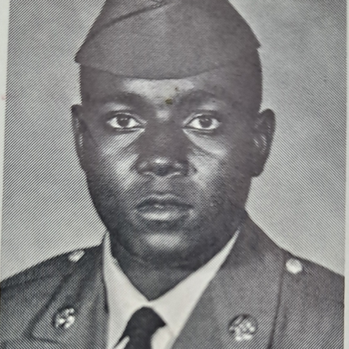
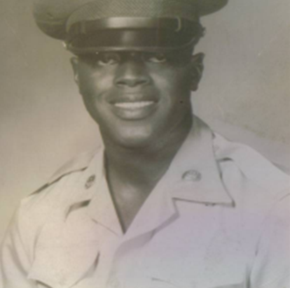
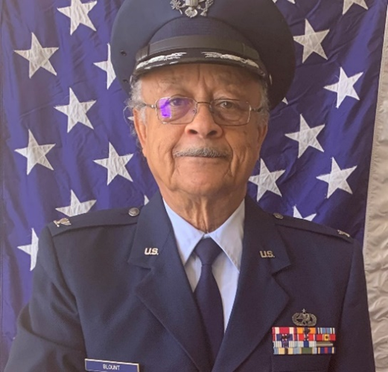
SPC ROBERT ROGERS
served 1967-1971
SP4 ELIJAH JOHN BENNETT
1941-2007
COL. WILSON BLOUNT
b. 1944
Elijah John Bennett, born in Savannah, Georgia, was an army PFC who was drafted into the army in the late 60s and served a little less than two years, one in Vietnam. His family moved to Brooksville, Florida, in 1946. Elijah was a member of Moton High School’s graduating class of 1961. He played basketball and football in high school and was active in New Farmers of America. He worked for the railroad and rock mine before he was drafted. Elijah earned multiple medals for his service, including two Bronze Stars for bravery; however, He had PTSD for the rest of his life and was in and out of the veteran’s hospital. He worked in construction and was declared a disabled veteran in the early 1970s. He passed the day before his 65th birthday. He married and was the father of three children. Throughout his service, Bennett earned the Vietnam Service Medal, 2 Bronze Stars, National Defense Service Medal, Republic of Vietnam Campaign Medal, Combat Infantry Badge, Marksman (M-16) Badge, Army Commendation Medal, Sharpshooter (M-16) Medal, Expert (M-60mm) Medal, and the Air Medal.
Central West Region, Hernando County
Colonel Blount was born in Cuthbert, Georgia, the 6th son of sharecroppers and descendants of Georgia slaves. Wilson earned his bachelor’s in Business Management from Tuskegee Institute (now Tuskegee University) in 1966. He was the first in his family to graduate from high school and college. While on active duty, Wilson earned a master’s in Public Administration from Ball State University (1974). He volunteers at Lacoochee Elementary School and the Democratic Party of Pasco County. He served a combined total of 27 years on active duty and in reserve. He is an active member of numerous organizations: Immediate Past President of the Tampa Bay Area Tuskegee University Alumni Club, 57- year member of Omega Psi Phi Fraternity, Founding member of General Lloyd W. Newton Chapter, Tuskegee Airmen Inc. (Albuquerque, NM), and Life Member of NAACP. Colonel Blount was the 2021 Keynote Speaker for the African American Heritage Society of East Pasco County’s 2021 Virtual Memorial Day Ceremony. He is married and has three daughters.
Central West Region, Hernando County
Home: New Smyrna Beach, Florida
Army, 1967-1971
Army Specialist (SPC) Rank: E-5
Crew chief
South Korea (not in Korean War)
Central East Region, Volusia County

Slide 24
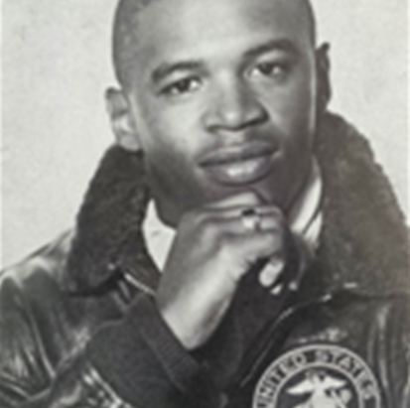
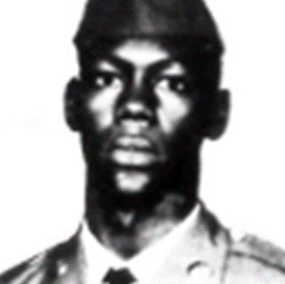
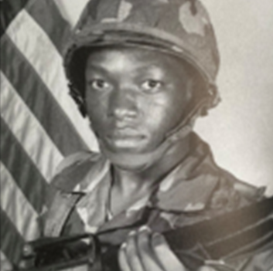
LCPL HERCULES MOORE
1947-1968
SP4 WASHINGTON MORRIS
1951-1969
SP4 TOMMY SMITH
1966-1985
Hercules “Billy” Moore (9/6/1947 – 5/26/1968) was born in Brooksville, Florida. He attended Moton High School and graduated class of ‘67. Billy was a sprinter and lettered in football, basketball, and baseball and was active in New Farmers of America. He enlisted in the Marine Corps and completed basic training at Paris Island, South Carolina. More than a dozen of his classmates were drafted or enlisted into military service. Before traveling to Vietnam, Hercules visited the home on furlough, giving him one more chance to speak with the football team. Months later, he was killed in action, leaving behind a wife and daughter and his parents and other relatives. The African American Heritage Society of East Pasco County, Inc. held a Memorial Day ceremony in 2018 to honor Billy on the 50th Anniversary of his demise. The following year, a Marine who served alongside him, William Woodhouse, came from West Virginia to participate in a similar Memorial Day Ceremony at the Spring Hill African American Cemetery, where Lance Corporal Hercules Moore is interred. He was recently inducted into the Hernando High School Sports Hall of Fame. He was a member of Ebenezer Baptist Church.
Central West Region, Hernando County
Specialist 4, US Army Washington “Leon” Morris Langley was born in Brooksville, Hernando County, Florida, and attended Moton High School. He was a neat dresser and loved basketball. Leon enlisted in the army and was allowed to visit home before commencing his tour in Vietnam. He was killed shortly after his arrival. Morris was awarded the Purple Heart, National Defense Service Medal, US Army Vietnam Service Medal, and the Republic of Vietnam Campaign Medal.
Central West Region, Hernando County
Specialist 4 Tommy Smith was one of 248 soldiers from Fort Campbell in Kentucky to perish in an aircraft crash in Grander, Newfoundland, on December 12, 1985. The soldiers were returning home from a six-month peace Keeping assignment in the Sinai Peninsula as a part of a Multinational Force & Observers. Specialist 4 Smith was born in Willow Grove, Pennsylvania, on January 8, 1965. His family moved to Brooksville, Florida, in 1966. He graduated from Hernando County Adult Education in June 1983, and he joined the Army in May 1984. He was a member of the 101st Airborne Division from Fort Campbell, Kentucky.
Central West Region, Hernando County

Slide 25
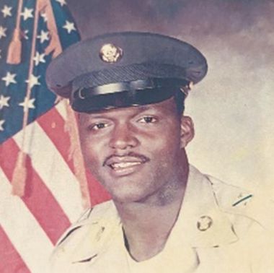
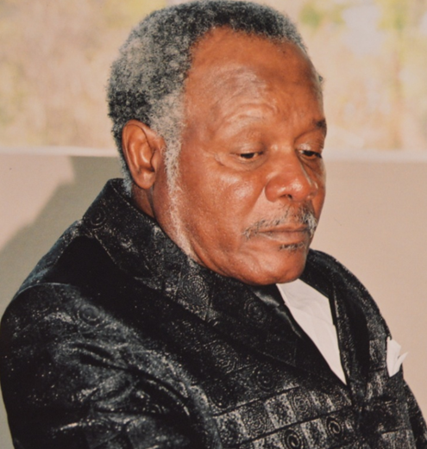
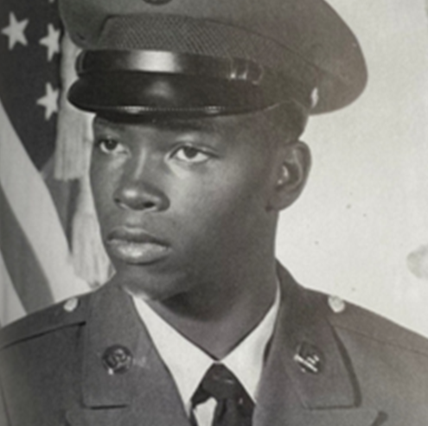
CPL SSG SAMUEL COOK
b. 1947
SGT. PAUL COLBERT
b. 1941
SP5 GALVIN FAGIN
1957-1982
Sergeant First Class Samuel Cook was born in Otter Creek, Levy County, Florida. His family moved to Brooksville, Hernando County when he was in elementary school. Samuel was a drummer in the Moton High School Band and became the head drum major his sophomore year. He played basketball, and when he graduated in 1964, he won a scholarship to Johnson Jr., College in Leesburg, FL. He enlisted into the army and served two tours in Vietnam. He retired as a member of the Army Reserve. He and his wife Fairella are the parents of two sons, Command Sergeant Major Kermit Cook and Sergeant Major Anthony Cook, retired USA, who passed in January 2021 due to complication of the COVID19 Virus. They are active members of Mt. Zion AME Church in Brooksville.
Central West Region, Hernando County
Sergeant Paul Colbert was born in Coleman, Sumter County, Florida. He attended Moore Academy and Mickens High School. In 1963, he enlisted in the US Army. He served for 13 years, including tours in Vietnam. He was the recipient of numerous medals. Paul worked as a truck driver and courtesy van driver. He retired from Davey Tree Expert Company. He attended the Million Man March and has been honored by the African American Heritage Society of East Pasco County, Inc., for the life he has lived and being honored by Pasco County Sheriff’s Office for serving in the Vietnam War. Paul is married and is the father of 13 children. Paul enjoys fishing, tailgating, and USF football.
Central West Region, Sumter County
Specialist 5, USA, Galvin Fagin III (12/24/1957 – 03/06/1982) was a native of Brooksville, Hernando County, Florida. He graduated from Hernando High School in 1975. He found direction in the army and was on tour at Scofield Army Base in Hawaii when he perished in a jeep accident.
Central West Region, Hernando County

Slide 26
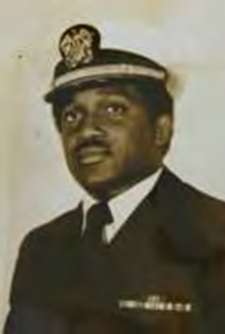
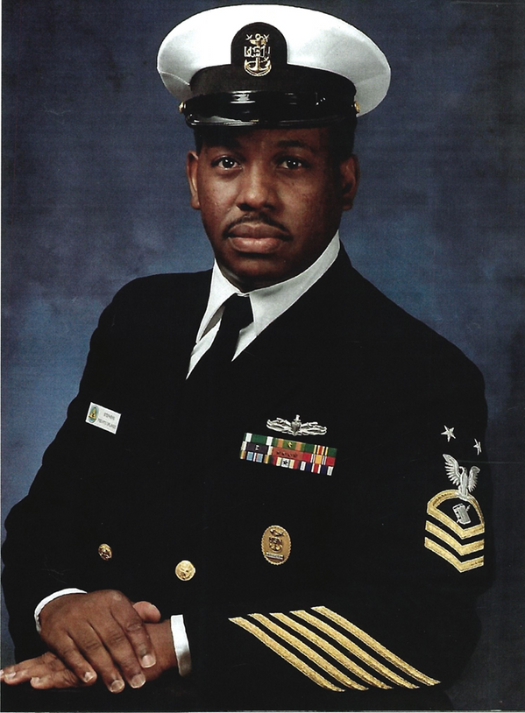
LT. ROLETTE THOMAS, SR.
1945-1975
PNCM (SW) STANLEY W. STEPHENS
United States Navy
Rolette Thomas Sr. was born to the union of Mr. & Mrs. Willie Thomas on 3 September 1945. He was the third of 3 children. He attended Baker Academy for elementary and middle school and graduated in 1963 from Dunbar High School in Fort Myers, Florida. He attended high school out of town since the city didn’t have a high school for colored students during segregation. Rolette was a good student, often making the honor roll in high school. He was the quarterback for the Dunbar Tiger football team during his junior and senior years. He was elected the class president during his senior year. In 1967 Rolette graduated from Morehouse College in Atlanta with a Bachelor of Arts degree. Three years later, he enlisted in the U.S. Navy. He was selected to attend the U.S. Naval Officer Candidate School in Newport, Rhode Island. He graduated and was commissioned an Ensign. Lt. Thomas was unfortunately killed in an altercation with another man at Georgia Power Co.'s Plant Arkwright near Juliette. He was truly a gentleman, well-liked, and respected by his men. He is buried at Carl Bailey Cemetery near Punta Gorda, Florida.
Southwest Region, Lee County
Master Chief Stephens was born in Tallahassee, Florida. He is a graduate of Lincoln High School and attended Florida Agricultural and Mechanical University. He enlisted in the United States Navy on 27 March 1970 and reported to Recruit Training Command, Orlando, Florida, on 29 June 1970 for basic training. After Personnelman Class "A" School at San Diego, California, he reported on 27 December 1970 to his first permanent duty station, Training Squadron SEVEN at Naval Air Station, Meridian, Mississippi. Subsequent duty stations were: Fleet Composite FIVE on Okinawa; USS BIDDLE (CG34) at Norfolk; Recruiting Orientation Unit, Orlando, Florida; Personnel Support Activity Detachment, Orlando, Florida; Enlisted Education Assistance Program (EEAP), Valencia Community College, Orlando, Florida; USS NASSAU (LHA 4) at Norfolk; Navy Management Systems Support Office, Chesapeake, Virginia; Personnel Support Activity Detachment, Orlando, Florida; and USS AMERICA (CV66), at Norfolk. He was awarded the Navy and Marine Corps Commendation Medal (w/gold star); Navy and Marine Corps Achievement Medal (w/gold star); Meritorious Unit Commendation; Navy "E" Ribbon (w/2 silver attachments; Navy and Marine Corps Good Conduct Medal (w/silver star); National Defense Service Medal (w/bronze star); Southwest Asia Service Medal (w/bronze star); Armed Forces Service Medal (w/2 bronze stars); Armed Forces Expeditionary Medal (w/bronze star); Humanitarian Service Medal; Sea Service Deployment Ribbon (w/3 bronze stars); and the Navy and Marine Corps Overseas Service Ribbon (w/bronze star). Master Chief Stephens' life was blessed when he married Denise H. Sneed of Portsmouth, Virginia, on 16 August 1980. He and Denise reside in Winter Springs, Florida, with their two beautiful daughters, Frances and Sharon.

Slide 27
War in Afghanistan
2001-2021
In 2001, Afghanistan was led by the Taliban, a fundamentalist Islamic militia that is said to have assisted with the September 11 attacks. The United States invaded Afghanistan in 2001, shortly after 9/11, and ousted the Taliban from the government. A new Democratic government was implemented while the Taliban fought an insurgency, leading to their controlling parts of the country at different times. This continued until around 2020, when the U.S. began removing its troops. The Afghanistan government succumbed to the Taliban after the evacuation of U.S. and allied personnel, allowing the Taliban to regain control of the country.

Slide 28
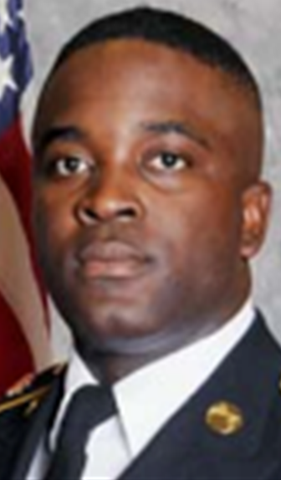
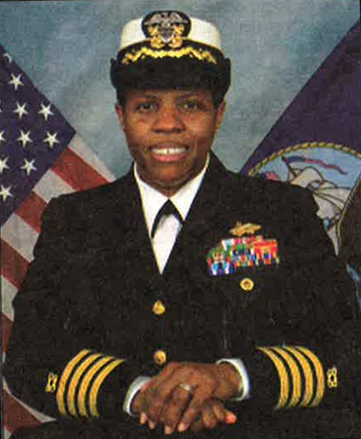
CAPT. LA TANYA SIMMS
served 1965-1967
La Tanya Simms has experience in leadership and program/project management experience in the U.S. Navy's Civil Engineer Corps (CEC), retiring at the rank of Captain after 26 years. She was the first African American woman in the CEC to rise to this rank in Navy history. Simms served in all facets of the CEC. In the Naval Construction Force (Seabees), she was an Officer in Charge in Naval Mobile Construction Battalion (NMCB) THREE; Chief Staff Officer, THIRTIETH Naval Construction Regiment; and Commanding Officer, NMCB FOUR. During those tours, she successfully led teams in Guam, Surabaya, Indonesia; Souda Bay, Greece; and Afghanistan in support of Operation ENDURING FREEDOM three times. Additionally, La Tanya garnered extensive facilities management and contract acquisition expertise in the Navy. Among other accomplishments, she led the development of restoration projects for Navy bases that sustained severe damage during Superstorm Sandy. One of her most memorable assignments was with Combined Disaster Assistance Center - Pakistan directing the engineering effort after a 7.6 magnitude earthquake devastated the Kashmir region in 2005. Post naval service in 2017, La Tanya led the capital programs team at Northwestern University in the design and construction of projects valued at over $1.5 billion, notably a new 14-story biomedical research facility in downtown Chicago and the renovation of the university's basketball and volleyball arena in Evanston, IL. Born and raised in Fort Myers, Florida, La Tanya holds a Bachelor of Architecture from Florida A&M University, Master of Arts in Urban and Regional Planning from the University of Florida, Master of Professional Studies (Business of Art and Design) from Maryland Institute College of Art, and a Professional Certificate in Graphic Design from Sessions College of Professional Design. She also completed Harvard Kennedy School's Senior Executive Fellows program.
Southwest Region, Lee County
SP4 CLARENCE WILLIAMS III
1989-2012
Specialist 4 Clarence Williams III of Brooksville, Hernando County, FL, wanted to see more of the world and follow in his father’s (corporal with the Florida Highway Patrol and army reservist) footsteps, so after graduating from high school, he enlisted in the army with plans of becoming a military police officer, and he achieved that. He served 5 years before perishing in an explosive attack during Operation Enduring Freedom. His service earned him the Purple Heart and Bronze Star. Clarence was assigned to the 978th Military Police Company and 93rd Military Police Battalion in Fort Bliss, Texas. In high school, He joined the Hernando Sheriff’s Office Explorer Post, a volunteer program meant to give teens a firsthand glance into law enforcement. While in the service, he earned an associate degree in criminal justice. He loved football, fishing, and hog hunting and sang in the choir at church.
Central West Region, Hernando County

Slide 29
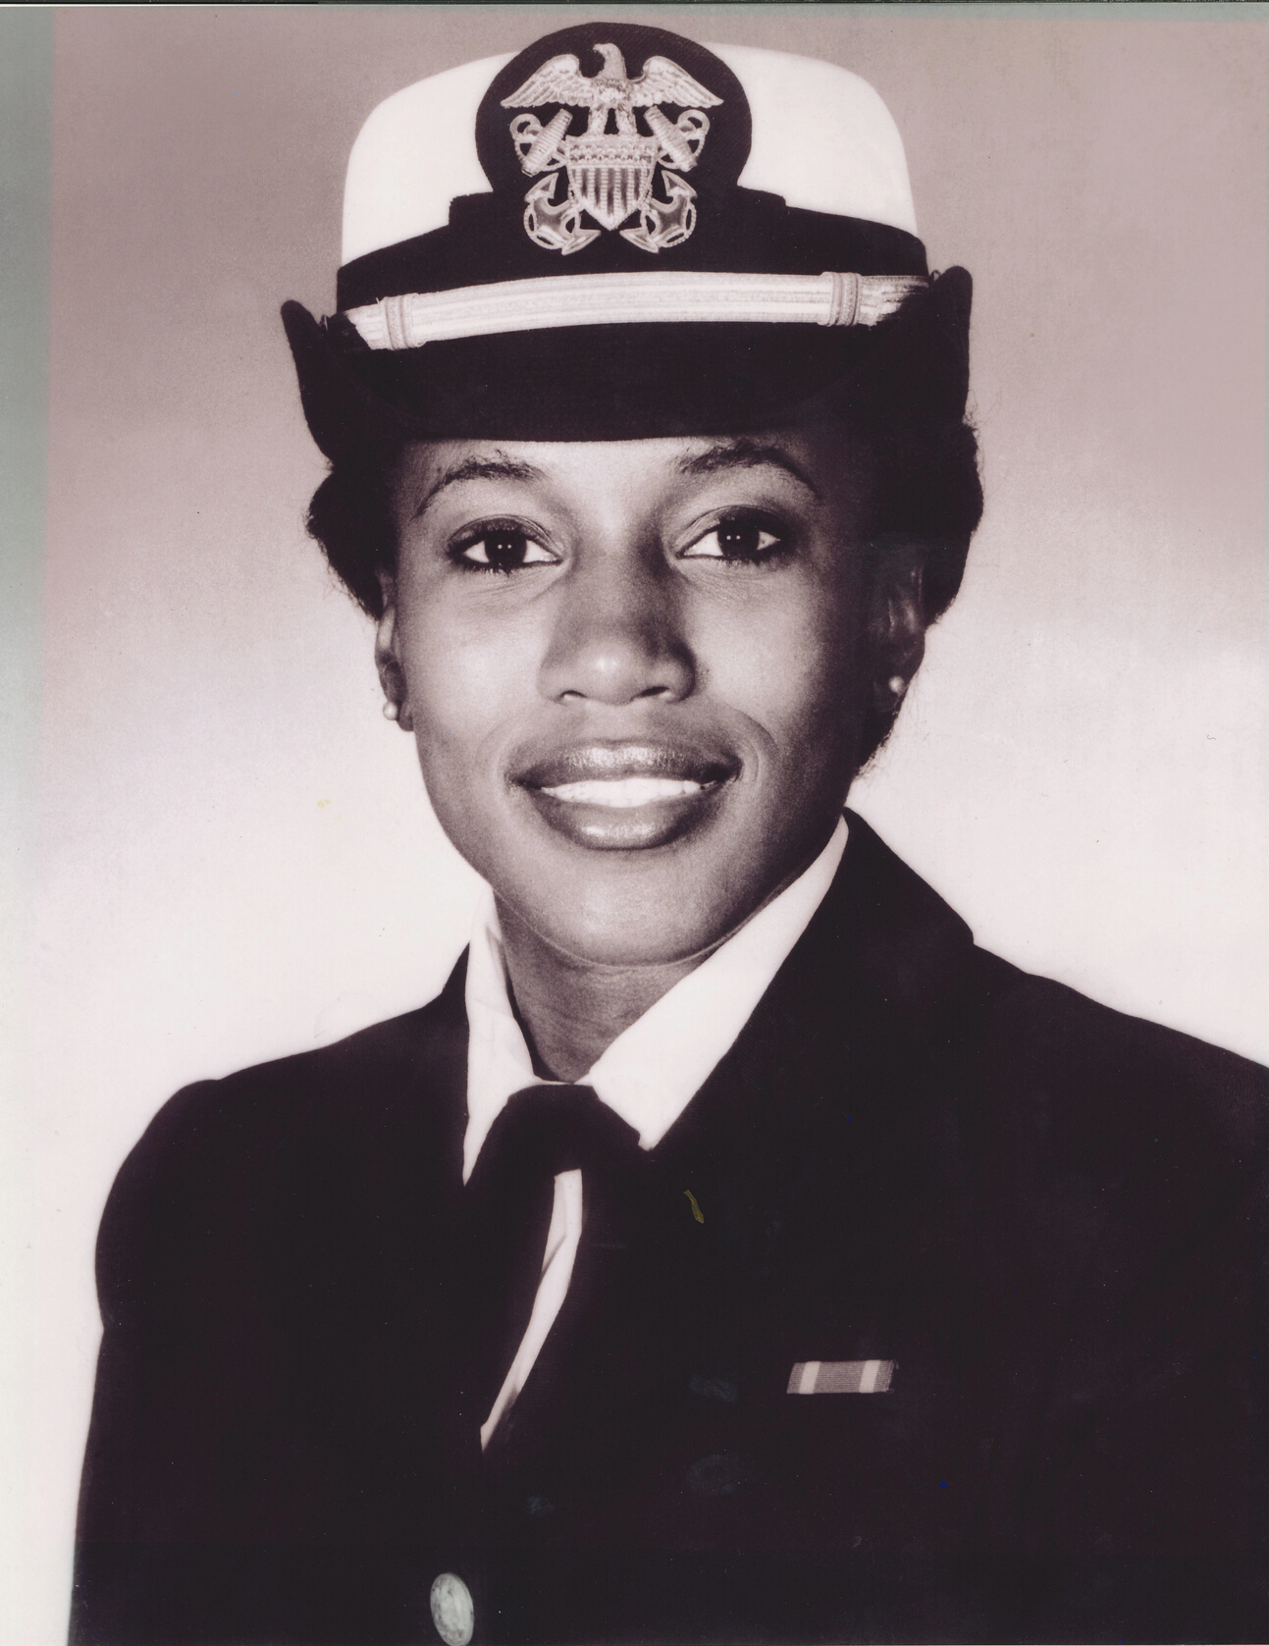
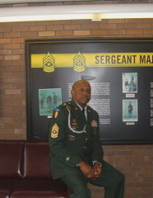
SERGEANT MAJOR JARVIS V. ROSIER SR.
U.S. ARMY RETIRED
DENISE POWELL
I am Sergeant Major Jarvis V. Rosier Sr. U.S. Army Retired. I served 34years of distinguish service to this great country of ours Defending our Democracy. Our democracy has been challenged many times and at times caused this country to go to war in defense of that. One such instance was the war in Afghanistan. It was a necessary war because our country was attacked from forces trained in Afghanistan in leading up to September 11, 2001.
The ultimate goal of this war was to find those who perpetrated the attack on the United States and we did after several years of conflict and the lost of thousands of Military Heroes who gave their lives for this country and the many who wear the scars of the Afghanistan conflict today.
I’m proud to say I was a part of defending our democracy in the Afghanistan in 2005 and 2006 and for that I was awarded the Bronze Star Medal February 18, 2006 for courage and commitment to mission accomplishment in a combat zone, under most extreme circumstances. May God continue to protect our Men and Women in uniform today who continue to operate as Defenders of Democracy.
North Central, Leon County
Denise Powell is a 1985 graduate of Florida A&M University with a B.S. in Political Science. She also earned an MBA in Aviation Marketing from Embry-Riddle Aeronautical University. Upon graduation from Florida A&M, Ms. Powell was commissioned as an officer in the United States Navy, in which she served for eight years of honorable service. She is certified in television production through People TV in Atlanta, Georgia. She is currently a full-time federal employee working as a technical writer-editor for the U.S. Department of Health and Human Services in Atlanta, Georgia, laying the groundwork for her impending early retirement and next chapter as a screenwriter and producer of scripted documentary film work.

Slide 30
“AFRICAN AMERICANS HAVE CONTINUALLY SERVED AS DEFENDERS OF DEMOCRACY. THANKS TO NEW LAWS AND EXECUTIVE ORDERS, THEY HAVE HAD ACCESS TO OPPORTUNITIES IN EDUCATION, EMPLOYMENT, AND LEADERSHIP THAT WAS ONCE EARLIER DENIED.”

